Slide 1
Geography-Aware Sequential Location Recommendation
Rao Xuan
2021-9-30

Slide 2
Research direction
Drawbacks
Solutions
Geographical information is still not effectively utilized.
Use either the BPR loss or the binary cross-entropy loss for optimization by selecting random samples from unvisited locations.
Embed the exact GPS of the location with a novel geography encoder.
Propose a new loss function based on importance sampling for optimization.
Put forward geography-aware negative samplers to promote the informativeness of negative samples.

Slide 3
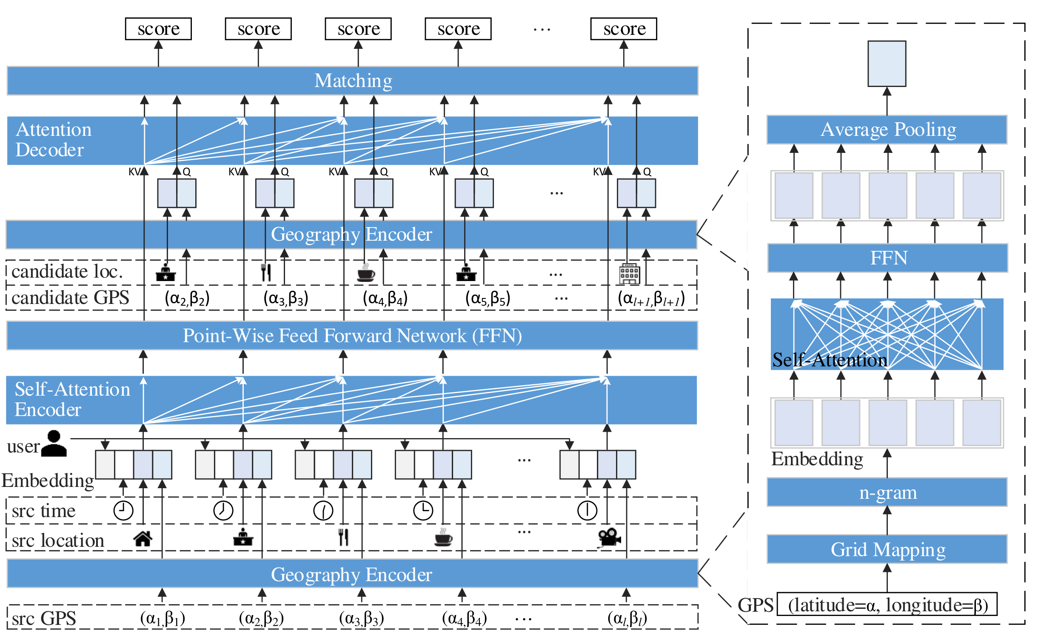
Framework

Slide 4
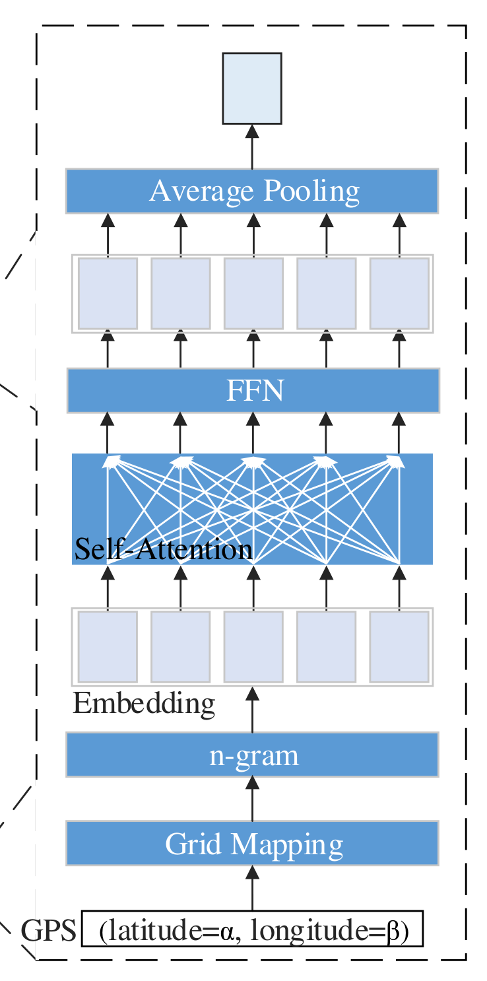
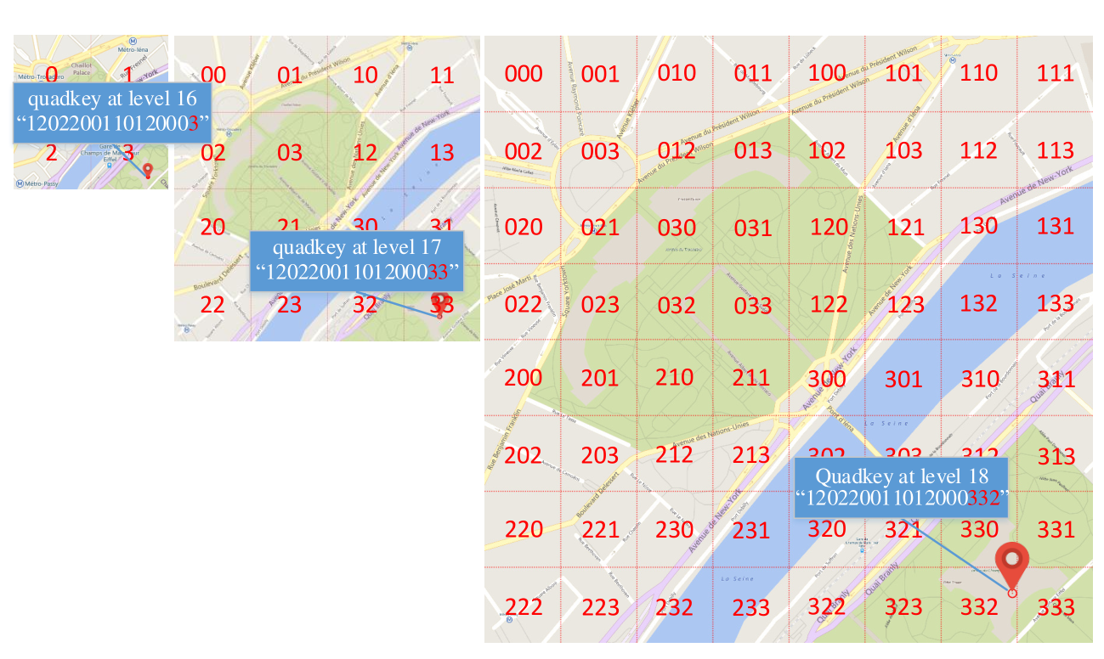
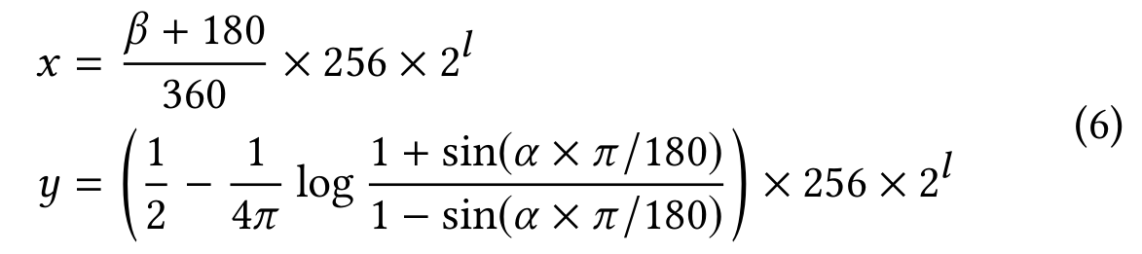
Geography encoder
Map Gridding
Project the entire world into a flat plane, which is cut into 4 grids of 256 x 256 pixels.
Each grid is divided into four sub-grids of the same size when the number of levels increases by one.
Notes:
The latitude and longitude of a GPS point is converted into a Cartesian coordinate.
The map from a Cartesian coordinate to a grid is simply achieved by dividing them by 256.

Slide 5
Geography encoder
Encoding Quadkeys
Because of grid division like quadtree, each grid can be identified with a quadtree key (quadkey for short), which can be interpreted as a base-4 number and whose length equals the level of detail.
Transform each quadkey into the sequence of n-grams first.
After embedding the sequence of n-grams, we apply a stacked self-attention network for capturing sequential dependence, and then aggregate the sequence of n-gram representations via average pooling.

Slide 6
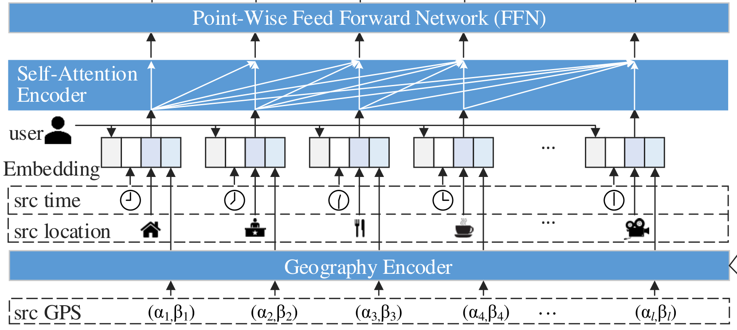
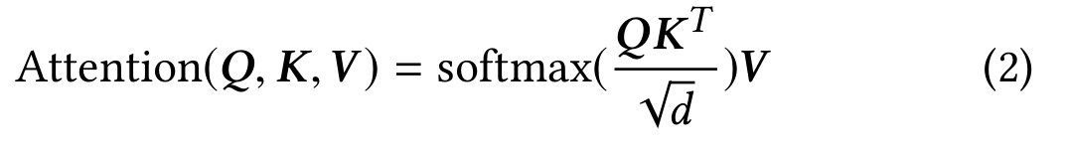
Self-Attention encoder
Embed user, hour of week and location of each behavior, and encode the exact GPS position with geography encoder. These vectors are concatenated, forming the representation matrix of the input sequence.
The self-attention encoder stacks multiple self-attention blocks, each of which consists of a self-attention layer and a point-wise feed-forward network (FFN).
When stacking multiple self-attention blocks, residual connection and layer normalization are applied in FFN and the self-attention layer.

Slide 7
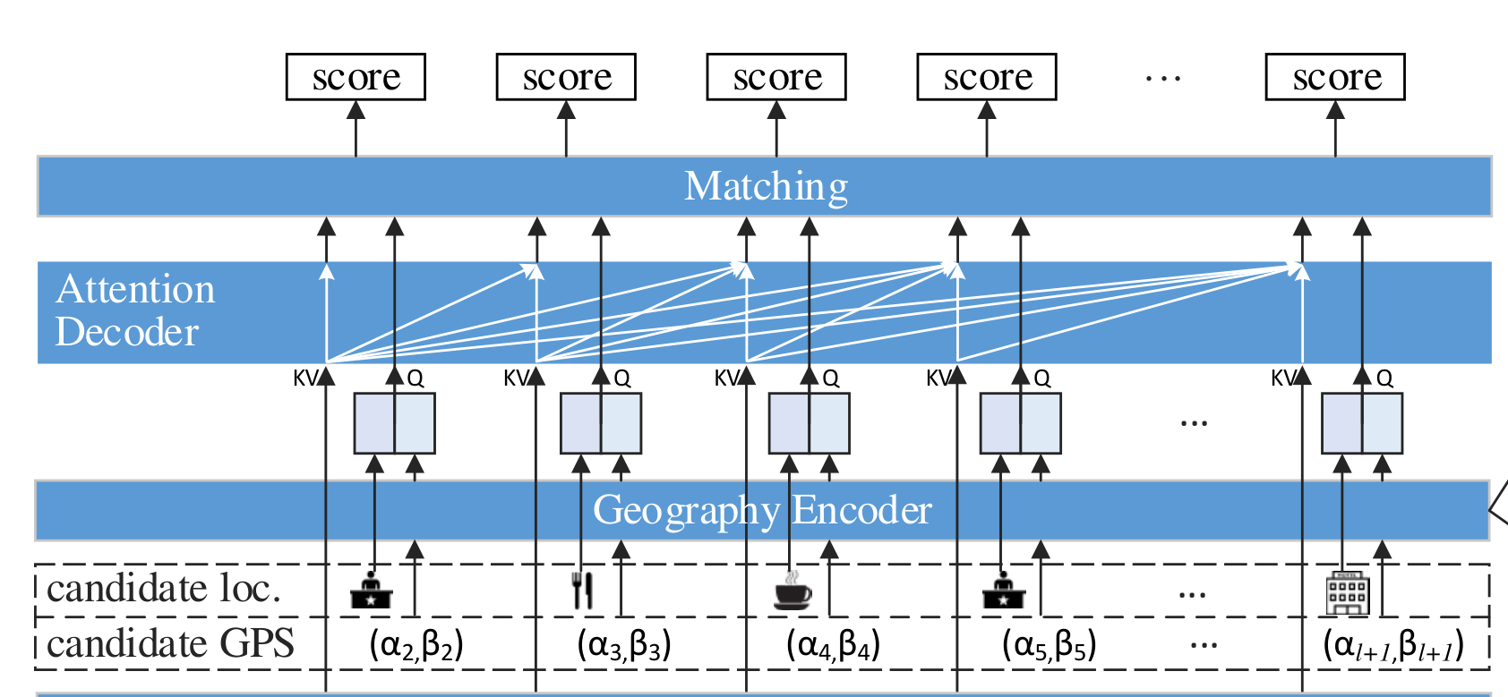

Target-aware Attention decoder
Most existing self-attention based recommenders directly feed these outputs into the matching module, which may be suboptimal.
Matching module: compute preference score for each candidate location with any matching function.

Slide 8
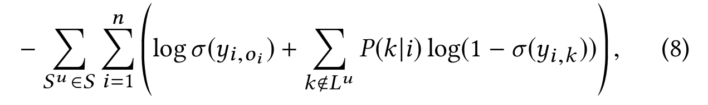
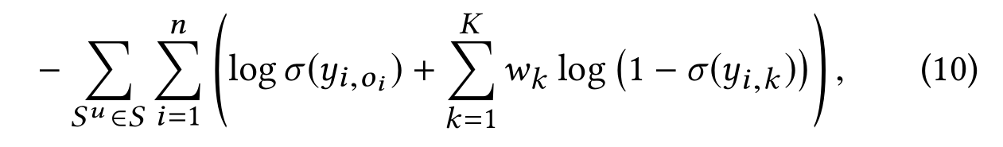
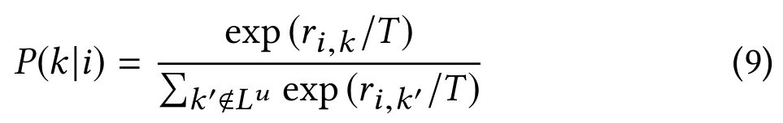
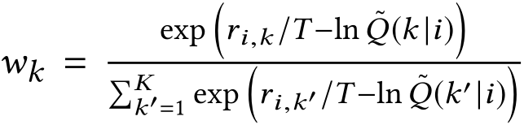
Loss Function with Importance Sampling
Unvisited locations with large preference scores can contribute more to gradient, so they are more informative and should be sampled with high probability.
Propose to approximate the expectation with importance sampling.
Suppose the proposal distribution is Q(k|i), denote by ˜Q(k|i) the unnormalized probability of Q(k|i).
This still suffers from low efficiency of computing normalization in the probability.

Slide 9
Geography-aware Negative Sampler
KNN-uniform based Negative sampling
geographical information can also be effective to distinguish negative from potentially positive in unvisited locations.
For example, when he/she visits the target location O, the unvisited locations around O maybe more likely to be negative.
Retrieve K nearest locations to the target location.
Randomly draw negative samples from these K candidates.

